Slide 1
Murder We Wrote

Slide 2
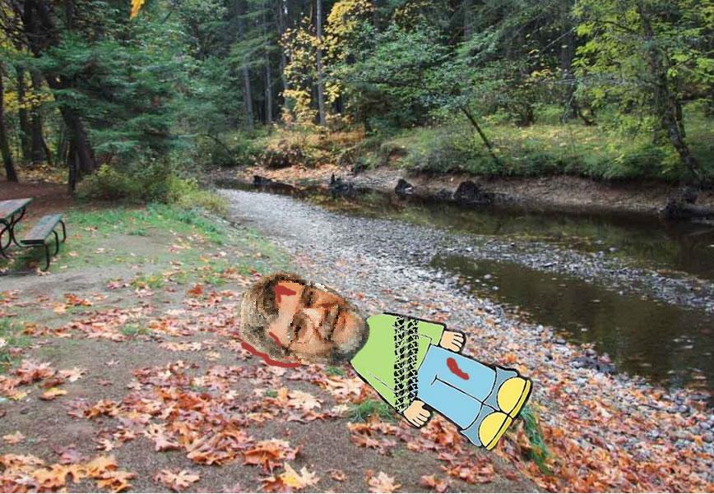
The Crime Scene

Slide 3
Background Information
Body found outside Legoland, Berkshire U.K.
Missing persons report filed the following day
Two pools of red liquid are located in the parking lot
Alan has no relevant medical conditions

Slide 4
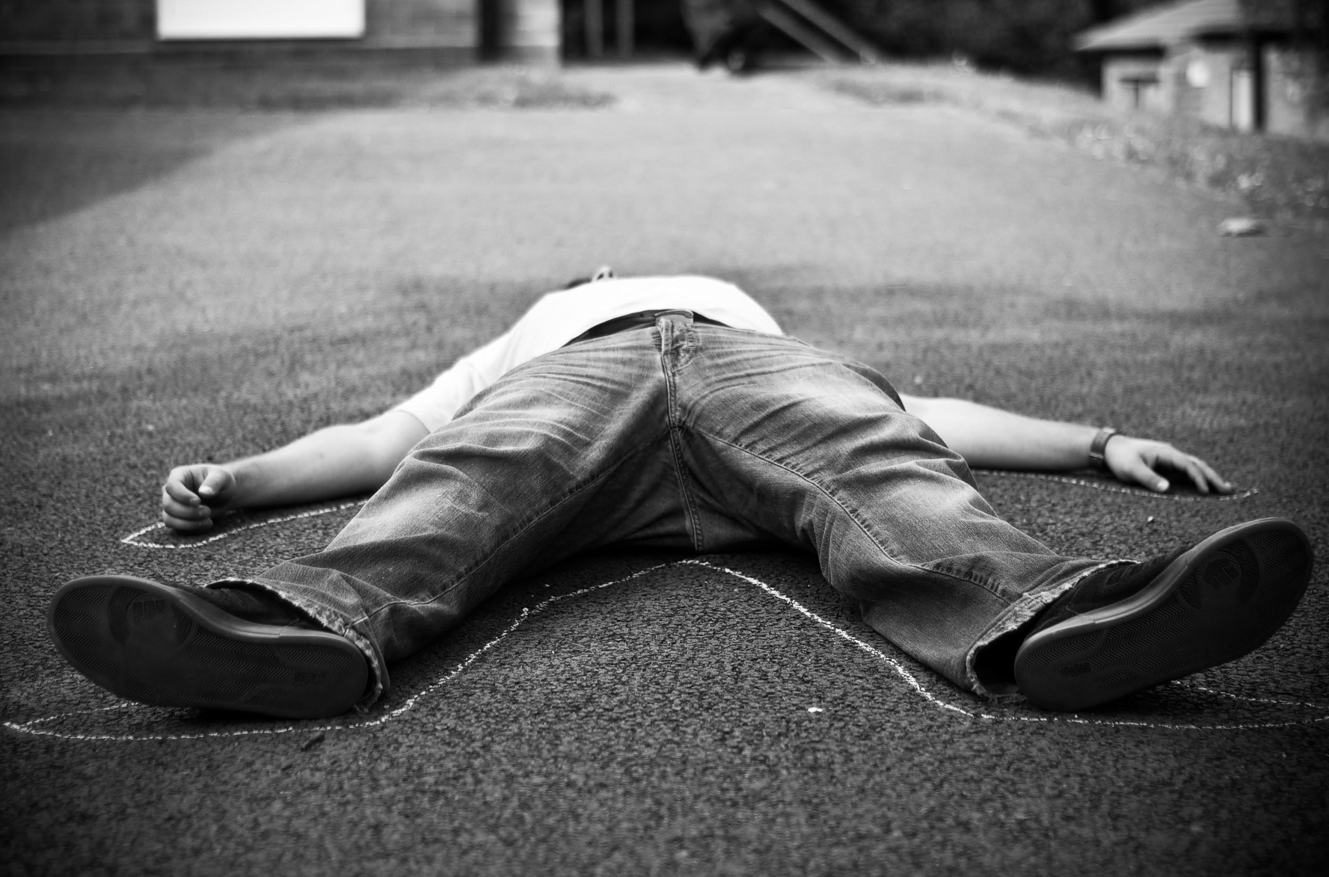
The Body
-Tire marks
-Head wound
-Broken leg
-Fractured ribs
-Strands of hair
-Silver paint chips
-Fly eggs and some maggots
-Liver temperature 22 degrees Celsius

Slide 5
The suspects
The parents:
Allan was the problem child
drive a silver car
police find damage and blood on car
The person whose DNA matches the hair found on Allan’s body:
criminal record
doing a comedy show at the amusement park that day

